Slide 1

Predictive Modeling
Team 2

Slide 2



Dataset
Rows: 87,282
Columns: 31
Each row is a separate accident in the NTSB (National Transportation Safety Board) files
There is basic identification information for record-keeping purposes, including
Location information
Airport information (where applicable)
Injury and aircraft damage information
Various aircraft descriptive information
Information from the accident investigation regarding weather, cause, and publication date

Slide 3
Business Problem
While there are a number of potential areas of research within the data, we would like to approach this from the perspective of a business consultancy specializing in the aviation industry who think that certain airplane manufacturers could benefit from an increased focus on safety.
For an accident involving a given make (manufacturer), how likely is it that a person will be killed or seriously injured rather than uninjured or minorly injured, after controlling for weather? As an example, following the analysis, maybe we will find that Cessnas are more likely to have crashes with serious or fatal injuries compared with Piper, Beech, or Bell aircraft. In that case, the target variable will be the percentage of seriously or fatally injured persons out of the total number of persons involved in the accident. This will be cross-referenced with the make, and we will then control for the weather (since it may not be fair to compare an accident in IMC conditions to WMC conditions).

Slide 4
Data Exploration (1/)
Columns hid and excluded:
Events.id, Accident.Number, Event.Date, Location, Country, Latitude, Longitude, Schedule, Airport.Code, Airport.Name, Aircraft.Category, Registration.Number, Report.Status, Publication.Date: Irrelevant to the target variable and analysis
Injury.Severity: Recoded to Injury Severity to only include the categories of Fatal and Non-Fatal. The earlier data included the number of fatalities as well
Model: Removed due to the high number of unique levels. Additionally, the data could be only used with ‘Make’ column
Amateur Built : Removed because it gives the same information as the amateur built values in ‘Make’ column
Air.Carrier: Removed because of 44,585 missing values

Slide 5
Data Exploration (2/)
Engine.Type: Recoded the missing values to unknown
Weather.Condition : Recoded the missing values to unknown (UNK)
Make: Initially had over 8,000 unique levels, which was brought down to 386 by recoding and removal of rows due to significant missing values in other columns
Columns Total.Fatal.Injuries, Total.Serious.Injuries, Total.Minor.Injuries and Total.Uninjured were used to form the target variable column, which was named Target Variable (Fatalities). This column denotes 1 in case the injuries were fatal or serious, and 0 if the injuries were minor or absent
We partitioned the data set into 50% Training, 30% Validation and 20% Test.

Slide 6
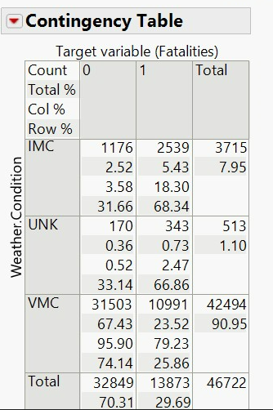
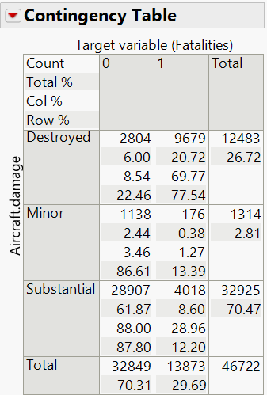
Data Exploration (3/)
Since, our data set has 7 nominal columns and only one continuous variable, we have a contingency table to compare our predictor variables with target variable
From the first contingency table we could interpret that the number of fatalities were greater during VMC weather condition (79.23% of the times)
From the second table it is understood that when there was a fatality, 69.77% of the times the aircraft was Destroyed and there was Substantial damage 28.96% of the times
Weather vs target variable
Aircraft Damage vs Target Variable

Slide 7
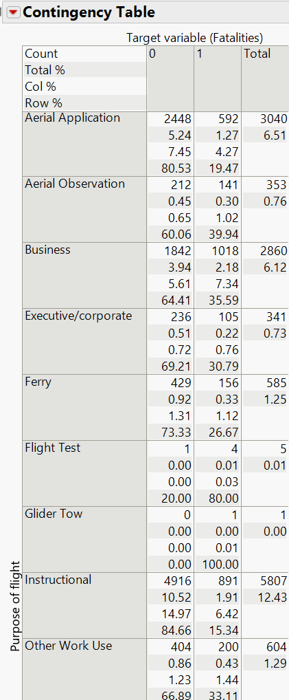
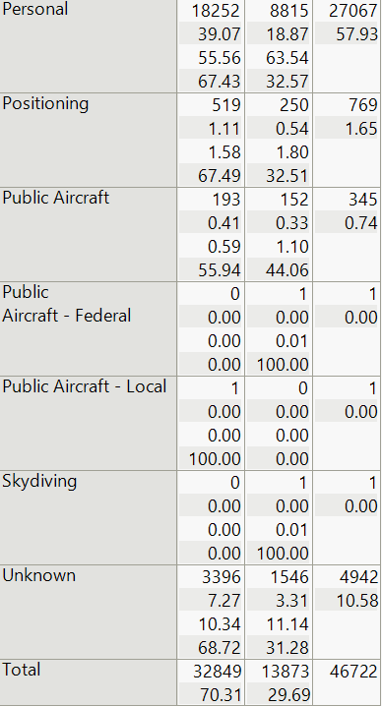
Data Exploration (4/)
Personal has the highest number records for Purpose of flight. Although there was a fatality only 32.57% of the times, an aircraft was used for Personal reason , it is a major contributor for the overall fatalities(63.54%)
Purpose of flight vs target variable

Slide 8
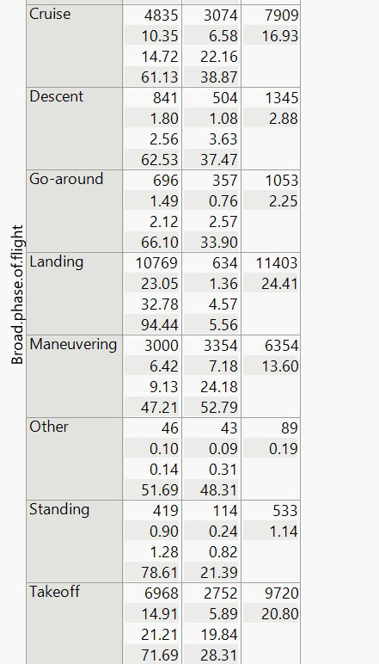
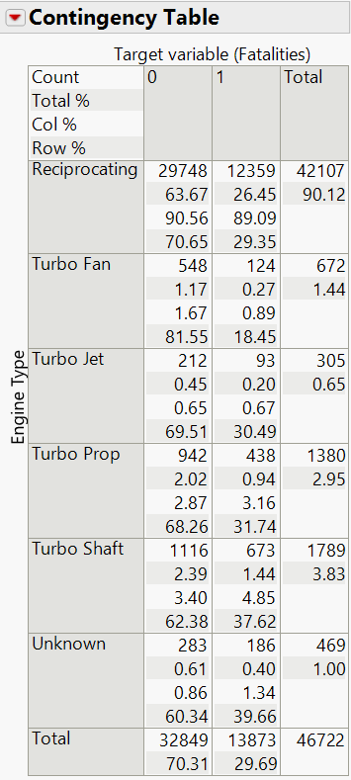
Data Exploration (5/)
For Phase of flight, we saw that the major number of fatalities were during Manoeuvring (24.18%) followed by Cruise (22.16%) and Take off (19.84%)
Aircrafts using reciprocating type of engines have the highest number of fatalities (89.09)
Broad Phase of Flight vs target variable
Engine Type vs target variable

Slide 9
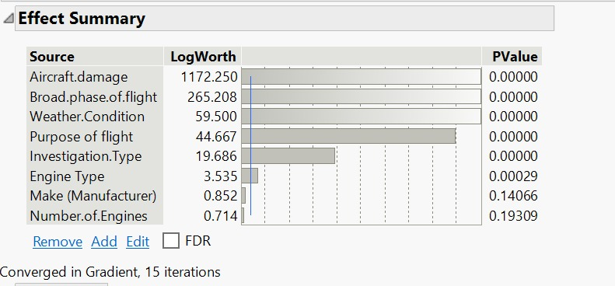
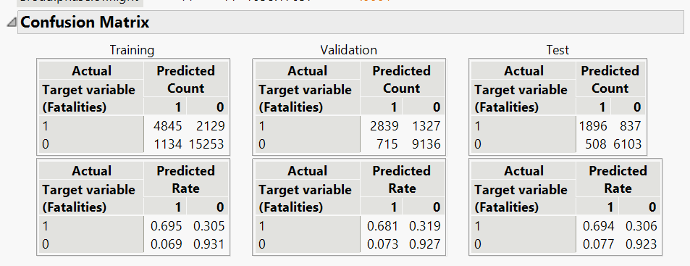
Models –Logistic Regression
Effect Summary shows that the log worth and p values for ‘Make’ and ‘Number of Engines’ have a p value greater than 0.05
This Confusion Matrix consists all the columns

Slide 10
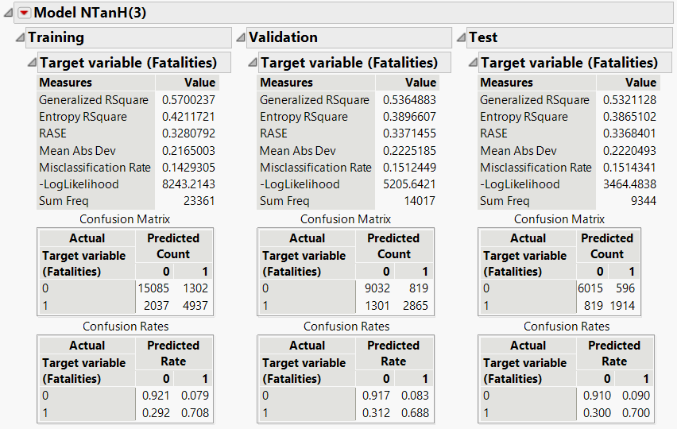
Models – Neural Network
The Misclassification percentage for Training, Validation and Test are 14.3%, 15.1%, 15.1% respectively
The misclassification rate has increased from Training to Validation set, which indicates that the data is overfit.
The Total Accuracy for Training, Validation and Test are 85.7 %, 84.9%, 84.9% respectively
The Accuracy of 1 prediction for Training = 79.13%
The Accuracy of 1 prediction for Validation= 77.76%
The Accuracy of 1 prediction for Test =76.25 %
Lift for Training, Validation and Test is 2.602, 2.61, 2.607 respectively.

Slide 11
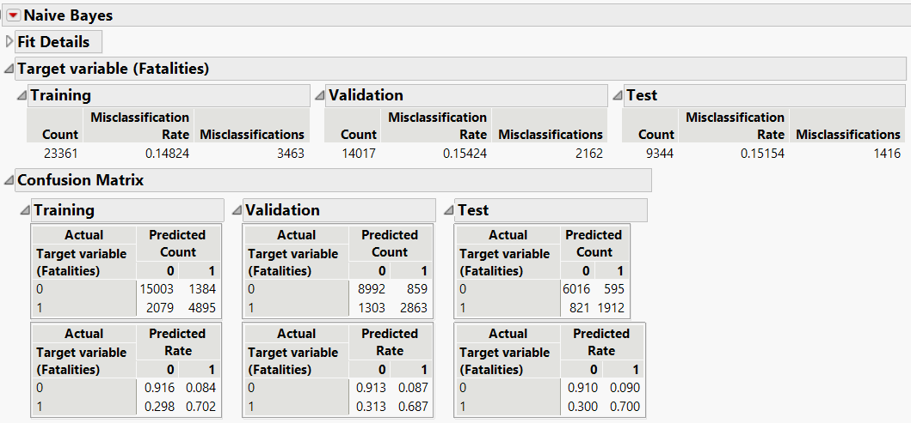
Models – Naïve Bayes (1/2)
The misclassification rate is 14.8% for training data, which has increased slightly to 15.4% for validation data and 15.2% for test data
The total accuracy of prediction for training data is 19,898/23,361 = 85.2%
The total accuracy of prediction for validation data is 11,855/14,017 = 84.6%
The total accuracy of prediction for test data is 7,928/9,344 = 84.9%
The accuracy of 1 prediction for training data is 4,895/6,279 = 78.0%
The accuracy of 1 prediction for validation data is 2,863/3,722 = 76.9%
The accuracy of 1 prediction for test data is 1,912/2,507 = 76.3%

Slide 12
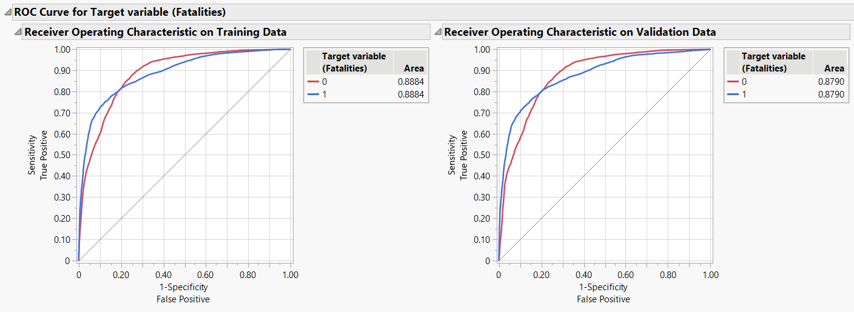
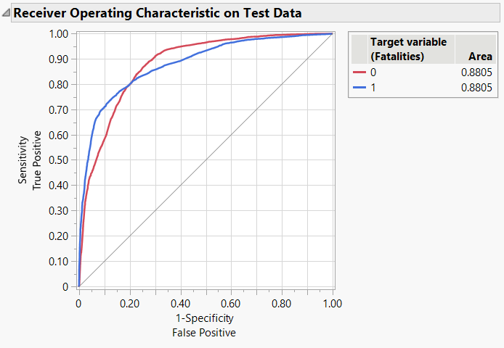
Models – Naïve Bayes (2/2)
Lift for training data = 78/29.8 = 2.62
Lift for validation data = 76.9/29.7 = 2.59
Lift for test data = 76.3/29.2 = 2.61
Used to predict categorical from categorical variables
Column “Number.of.Engines” had the lowest logworth, and hence wasn’t converted from numerical to categorical
The area under the ROC curve is 0.888 for training, 0.879 for validation and 0.881 for test

Slide 13
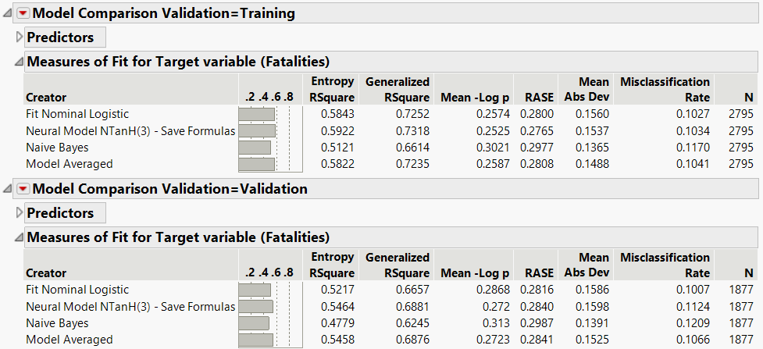
Models – Ensemble
In validation, RASE is lowest in Nominal Logistic while Neural Network has the largest R Square

Slide 14
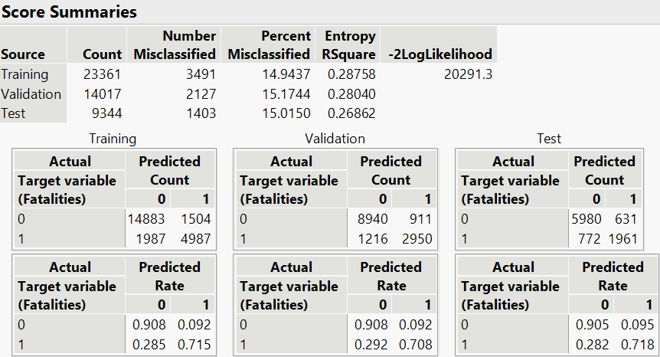
Models –Discriminant Analysis (1/2)
Since, all the predictor variables are nominal categorical variables , we attempted to convert these columns into indicator columns for the analysis except for the column ‘Make’ as it has 386 values
The Misclassification percentage for Training, Validation and Test are 14.94 %, 15.17%, 15.01% respectively
The Total Accuracy for Training, Validation and Test are 85.06%, 84.83%, 84.99% respectively
The Accuracy of 1 prediction for Training = 76.82%
The Accuracy of 1 prediction for Validation= 76.40%
The Accuracy of 1 prediction for Test = 75.65%

Slide 15
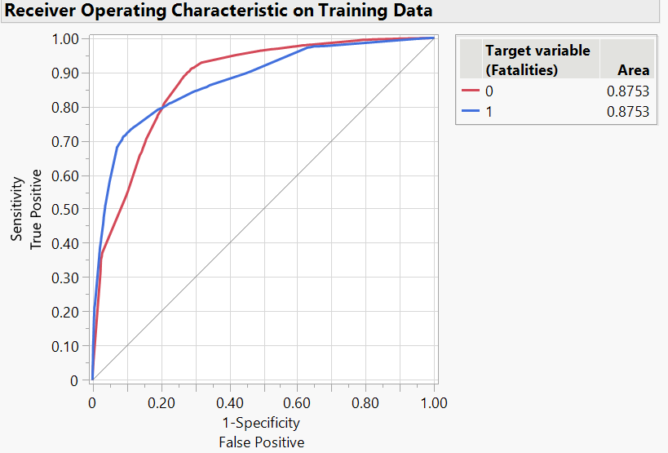
Models –Discriminant Analysis (2/2)
Lift for Training = 2.57
Lift of Validation = 2.57
Lift for Test = 2.52
The Area Under the Curve = 0.8753

Slide 16
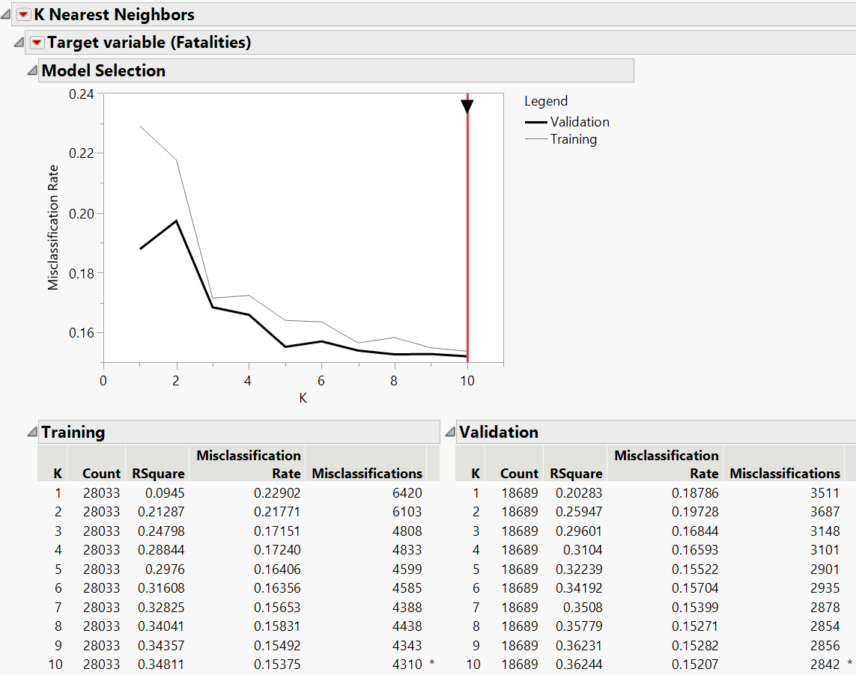
Models – KNN(1/2)
K value of 10 has has lowest error rate in validation data
. K value of 10 has highest R square value of 0.34811 for training and 0.36244 for validation
. The misclassification rate is 0.153 for training data and has reduced to 0.152 for validation data.

Slide 17
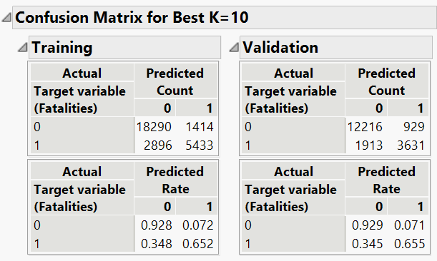
Models – KNN(2/2)
. The total accuracy of prediction for training data is 23723/28033=0.847
. The total accuracy of prediction for validation data is 15847/18689=0.848
. The accuracy of 1 prediction for training data is 5433/6847=0.793
. The accuracy of 1 prediction for validation data is 3631/4560=0.796
. Lift for training data is 0.793/0.297=2.67
. Lift for validation data is 0.796/0.296=2.68

Slide 18
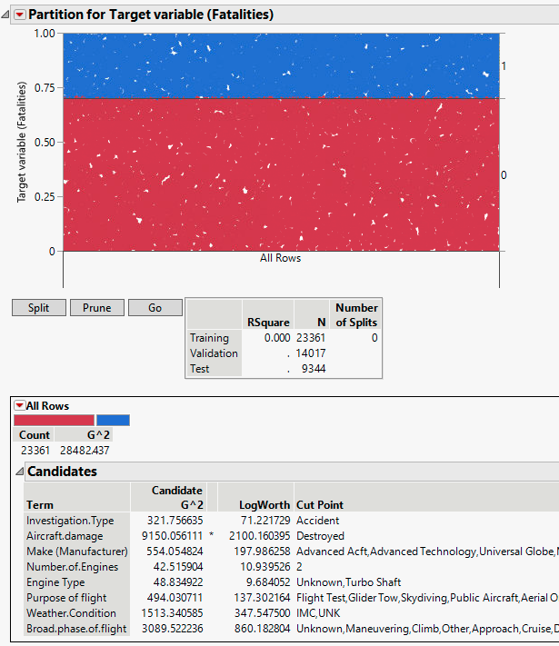
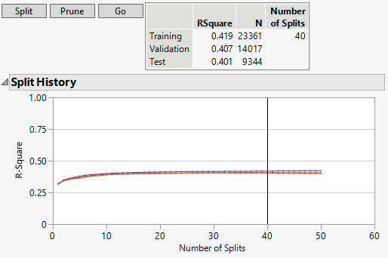

Models – Decision Tree (1/3)
Note the very high LogWorth values to choose from.
We can also prune back the number of split significantly.

Slide 19
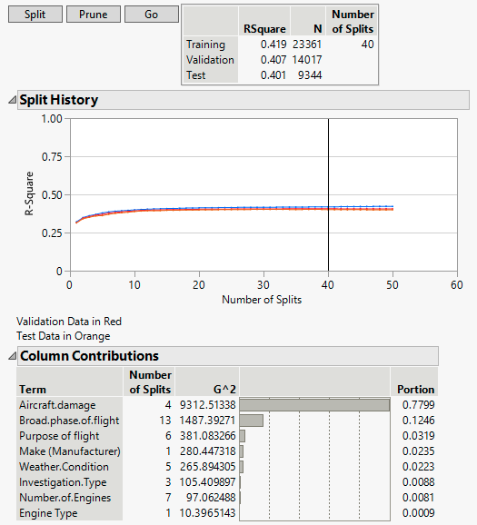
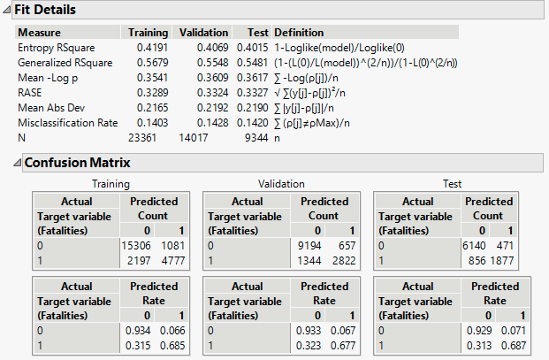
Models – Decision Tree (2/3)
Aircraft damage is clearly the largest contributor.
The misclassification rate can’t really improve beyond ~14%.

Slide 20
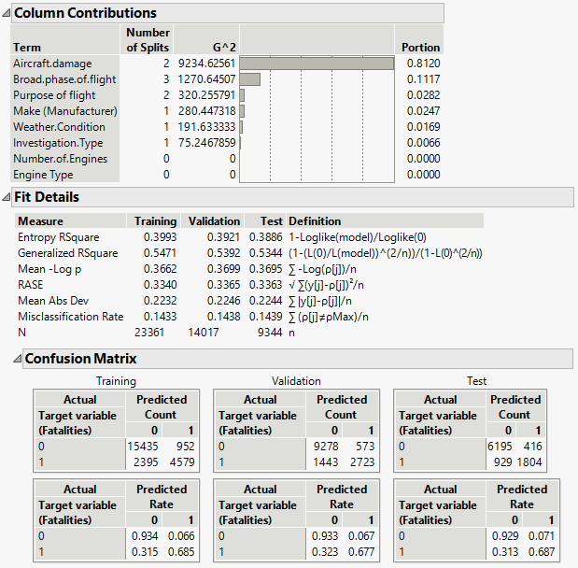
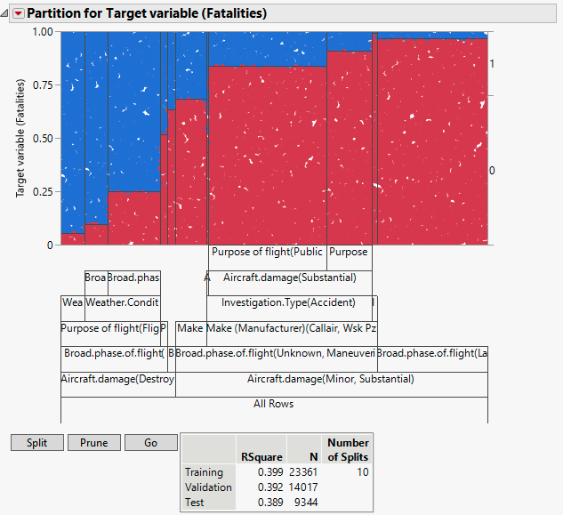
Models – Decision Tree (3/3)
This is after pruning back to 10 splits.
You can see that the model doesn’t improve.

Slide 21
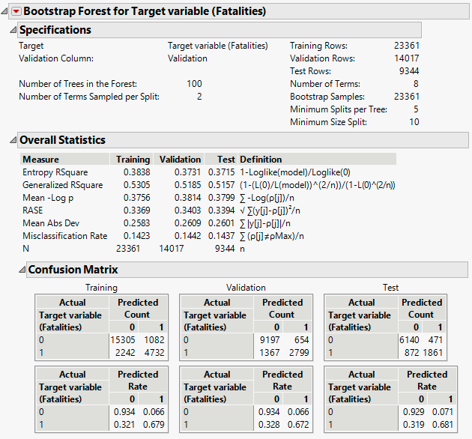
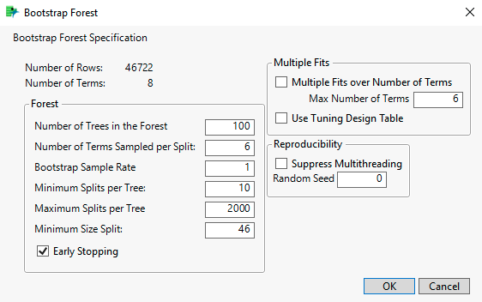
Models – Bootstrap Forest
Skipping the regression tree (irrelevant).
The default bootstrap forest values can get tweaked.
No real improvement over the decision tree.

Slide 22
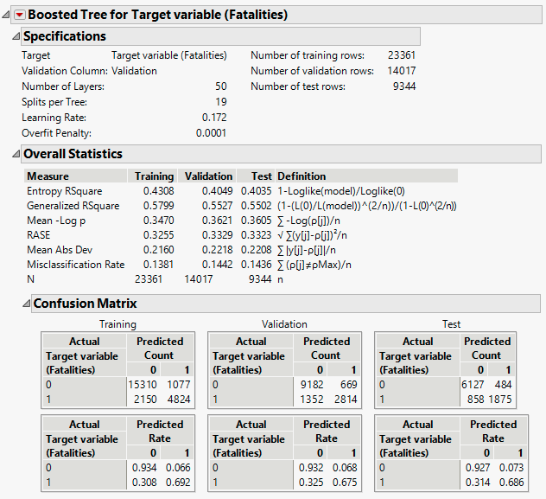
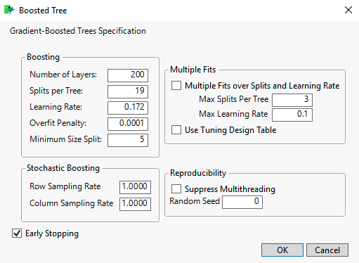
Models – Boosted Tree (1/2)
We left the defaults for this model.
We still don’t get improvement over
the decision tree.

Slide 23
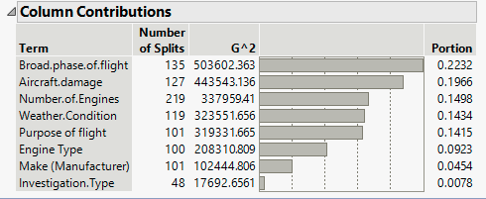
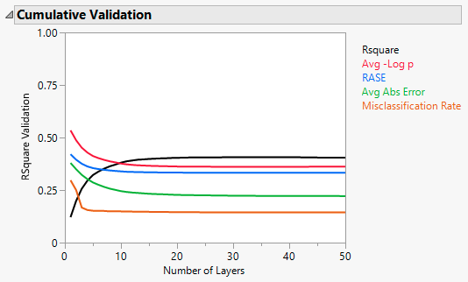
Models – Boosted Tree (2/2)
With the boosted tree model, other variables get a chance to contribute.
Still, the predictive value of the model is limited.
Tree models are well suited to the business problem being investigated, and the failure to get better than ~14% misclassification rate points toward areas for future study.

